Slide 1




Slide 2

N QUEENS

Slide 3

TEST TIME ON MAZE SOLVING
URL:https://forms.gle/AEkomEEm51wVk58EA
QR CODE:

Slide 4
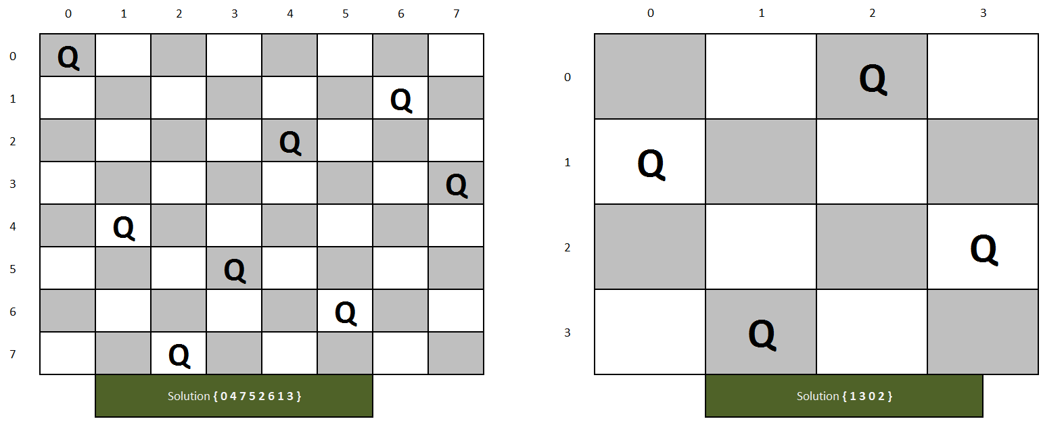
N-QUEENS PROBLEM
Introduction
The N-Queens problem is a classic combinatorial puzzle and a well-known problem in the field of computer science and mathematics. It involves placing N chess queens on an N×N chessboard in such a way that no two queens threaten each other. In other words, no two queens can share the same row, column, or diagonal on the chessboard.

Slide 5
N-QUEENS PROBLEM
Key rules of the N-Queens problem:
No Two Queens in the Same Row: There can be at most one queen in each row of the chessboard.
No Two Queens in the Same Column: There can be at most one queen in each column of the chessboard.
No Two Queens in the Same Diagonal: No two queens can be placed in positions where they can attack each other diagonally.

Slide 6
N-QUEENS PROBLEM
Goal of the N-Queens problem:
The goal is to find all possible solutions or configurations in which N queens can be placed on the N×N chessboard without violating these rules.

Slide 7
N-QUEENS PROBLEM
The N-Queens problem is named because it can be applied to chessboards of various sizes, where N represents the size of the board (e.g., 4x4, 8x8, etc.). Solving the N-Queens problem efficiently is a challenging task and is often used as an example in algorithm design and optimization. It has applications in artificial intelligence, constraint satisfaction problems, and optimization algorithms.

Slide 8
N-QUEENS PROBLEM
Backtracking Method of solving
The idea is to place queens one by one in different columns, starting from the leftmost column.
When we place a queen in a column, we check for clashes with already placed queens.
In the current column, if we find a row for which there is no clash, we mark this row and column as part of the solution.
If we do not find such a row due to clashes then we backtrack and return false.

Slide 9
N-QUEENS PROBLEM
Backtracking Algorithm
1) Start in the leftmost column
2) If all queens are placed return true
3) Try all rows in the current column.
Do following for every tried row.
a) If the queen can be placed safely in this row then mark this [row, column] as part of the solution and recursively check if placing queen here leads to a solution.
b) If placing the queen in [row, column] leads to a solution then return true.
c) If placing queen doesn't lead to a solution then unmark this [row, column] (Backtrack) and go to step (a) to try other rows.
4) If all rows have been tried and nothing worked, return false to trigger backtracking.

Slide 10
N-QUEENS PROBLEM
Program
You are given a Java program that solves the N-Queens problem. The program takes an input integer N representing the size of the chessboard and then attempts to find a valid placement of N queens on an NxN chessboard without any two queens threatening each other. If a solution exists, it prints the board with queens represented as 'Q' and empty cells as '-'. If no solution exists, it prints "No solution exists."

Slide 11
N-QUEENS PROBLEM
Sample input
Enter the board size (N): 5
output
Solution found:
Q - - - -
- - - Q -
- Q - - -
- - - - Q
- - Q - -

Slide 12
N-QUEENS PROBLEM
import java.util.Scanner; public class NQueens { public static void main(String[] args) { Scanner sc = new Scanner(System.in); System.out.print("Enter the board size (N): "); int n = sc.nextInt(); char[][] board = new char[n][n]; for (int i = 0; i < n; i++) { for (int j = 0; j < n; j++) { board[i][j] = '-'; } } if (solveNQueens(board, 0, n)) { System.out.println("Solution found:"); | printSolution(board, n); } else { System.out.println("No solution exists."); } } public static void printSolution(char[][] board, int n) { for (int i = 0; i < n; i++) { for (int j = 0; j < n; j++) { System.out.print(" " + board[i][j] + " "); } System.out.println(); } } public static boolean isSafe(char[][] board, int row, int col, int n) {

Slide 13
SOLUTION
int i, j; // Check this row on the left side for (i = 0; i < col; i++) { if (board[row][i] == 'Q') { return false; } } // Check upper diagonal on the left side for (i = row, j = col; i >= 0 && j >= 0; i--, j--) { if (board[i][j] == 'Q') { return false; } } // Check lower diagonal on the left side for (i = row, j = col; i < n && j >= 0; i++, j--) { if (board[i][j] == 'Q') { return false; }} | return true; } public static boolean solveNQueens(char[][] board, int col, int n) { if (col >= n) { return true; } for (int i = 0; i < n; i++) { if (isSafe(board, i, col, n)) { board[i][col] = 'Q'; if (solveNQueens(board, col + 1, n)) { return true; } board[i][col] = '-'; } } return false; } }

Slide 14
N-QUEENS PROBLEM
Optimization
The idea is not to check every element in right and left diagonal instead use property of diagonals:
1. The sum of i and j is constant and unique for each right diagonal where i is the row of element and j is the column of element.
2. The difference of i and j is constant and unique for each left diagonal where i and j are row and column of element respectively.

Slide 15
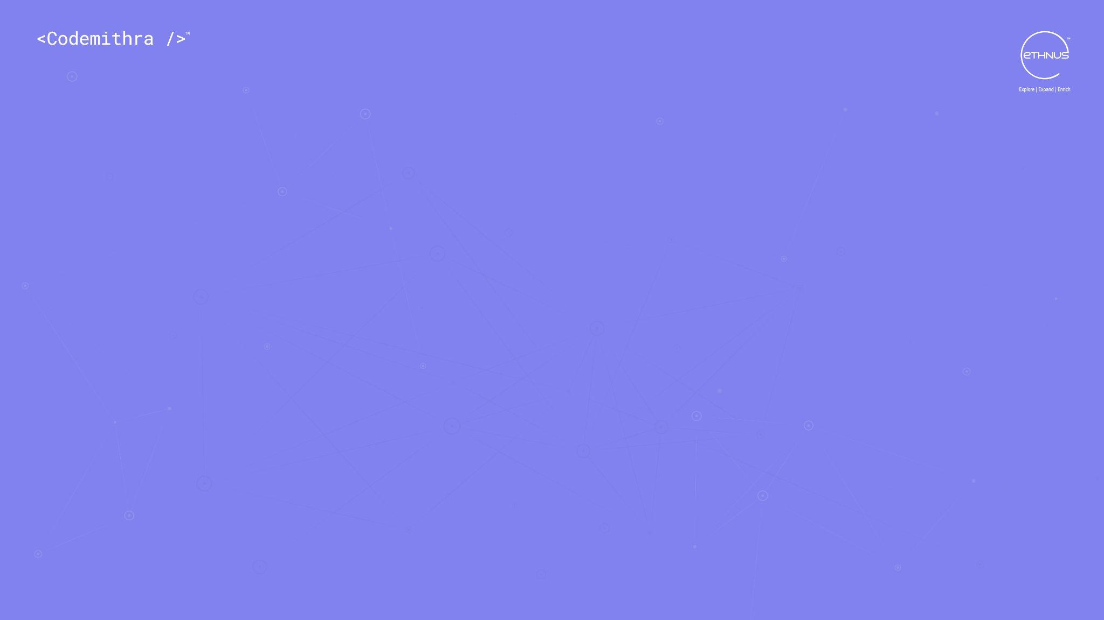



THANK YOU
+91 78150 95095
codemithra@ethnus.com
www.codemithra.com

